Slide 1
On-Line Conclave Registration Northeast Region Gathering of Leaders

Slide 2
Paper Registration vs. On-Line
Paper
Has been used for years. It’s free.
Slow. Many steps involved. Each step is an opportunity for problems.
Data access is limited to whomever has the papers.
On-Line
Fast. Eliminates “middle-man” steps. Data can be rapidly accessed by those who need it.
Direct email communication with each participant.
There is a financial cost.

Slide 3
Options Researched
NE-6A Researched:
SectionMaster
DoubleKnot
Google
NE-6A Selected SectionMaster
This presentation covers SectionMaster only.

Slide 4
SectionMaster

Slide 5
SectionMaster
One-stop event registration and merchandise portal
Built specifically for OA sections
Not an official OA or BSA product
Created by Arrowmen for Arrowmen
Used by several sections – mainly in Western Region
No affiliation with TroopMaster or with Order of the Arrow LodgeMaster

Slide 6
SectionMaster
SectionMaster is the Cadillac.
Definitely the most fully featured option.
Costs are significant.

Slide 7
SectionMaster
On-line registration on an individual basis.
Collects all necessary information from the registrant.
Completely handles trading post pre-orders
Item photos
Prices
Quantities

Slide 8
SectionMaster Payment Options
Two payment options:
Credit card
Register now and pay in person at conclave
System can be configured to allow either or both options for a particular conclave.

Slide 9
SectionMaster Paper Registration
CoC can choose to require on-line registration or to provide both on-line and paper registration options.
If paper registration is allowed, the section will need to develop a paper registration form that asks for all of the same information as the on-line process.
Someone would need to manually enter paper registration data into SectionMaster.

Slide 10
SectionMaster & Training Sessions
SectionMaster can be optionally configured to include training session sign-up as part of the registration process.
This is similar to the NOAC registration process.

Slide 11
Multi-Level Registration Fee
Both simple flat registration fees and multi-level registration fees are supported.
Customizable multi-level registration fees can be used to encourage specific behavior.
Early payment
Youth participation
New member participation
See handout for examples.

Slide 12
SectionMaster Data Access
On-line functions for designated section and/or conclave leaders to access current registration and TP order data
At the push of a button, these data will be emailed to customizable distribution lists (e.g. leaders of each lodge)
Hook to automatically display current registration statistics on the section web site.

Slide 13
SectionMaster Desktop
Desktop component for use during the conclave itself.
Accesses all of the data from on-line registration.
Functions to support:
On-site check-in
Complete registration of walk-ins
Training schedules
Patch auction tracking
Trading post order management

Slide 14
SectionMaster Funds Collected
Funds collected from on-line credit card payments are mailed by check to wherever the section wants.
Section staff adviser is required to provide written approval of check destination.
Checks usually sent monthly, but other schedules can also be arranged.

Slide 15
SectionMaster Fees
Description | Cost | Frequency
Per-event setup fee (varies by contract) | $150-300 | once per annum/event
Credit card transaction fee | $0.29 | per authorized credit transaction
Credit card discount charge (Visa, MasterCard, & Discover) | 2.99% | variable charge on all credit transactions
Credit card discount charge (American Express) | 3.79% | variable charge on all credit transactions
Incremental surcharge threshold | 200 | maximum registrations before surcharges
Incremental surcharge fee | $0.55 | per registration after threshold

Slide 16
SectionMaster Fees
In 2012 for NE-6A, the total cost worked out to $2.50 per conclave participant.
This figure depends on number of participants, TP pre-orders, etc.
Your mileage may vary.
Could choose not to allow credit card payments
Significant cost reduction
All participants would register on-line but pay in person at the conclave.
Lack of pre-payment could be a financial risk.

Slide 17
SectionMaster Screen Shots

Slide 18
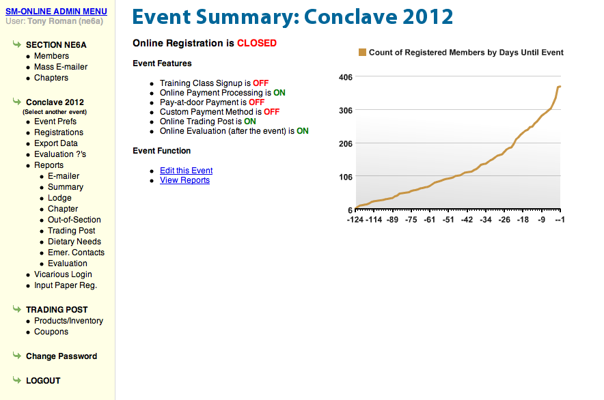

Slide 19
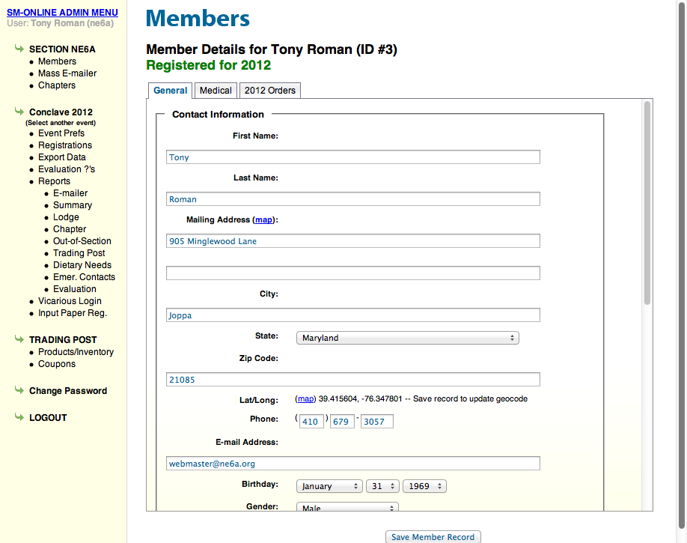

Slide 20
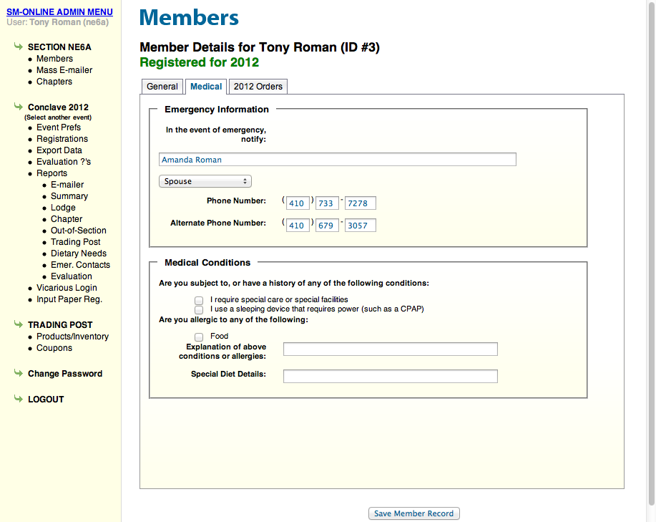

Slide 21
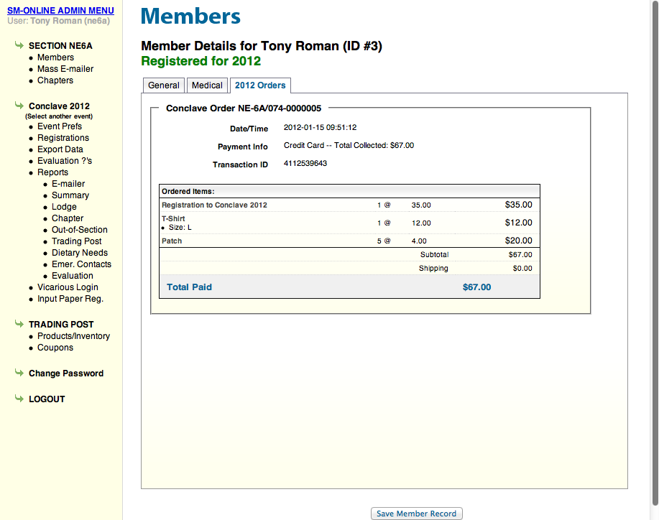

Slide 22
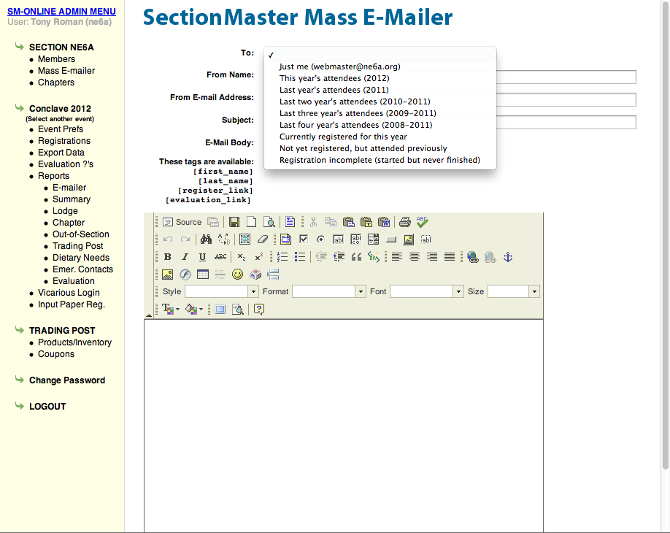

Slide 23
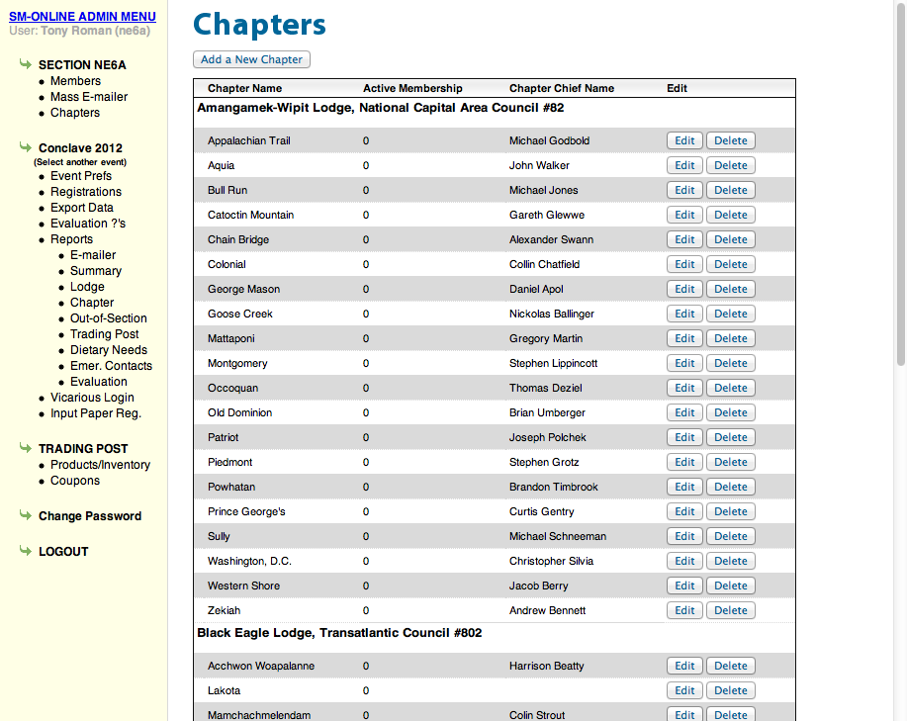

Slide 24
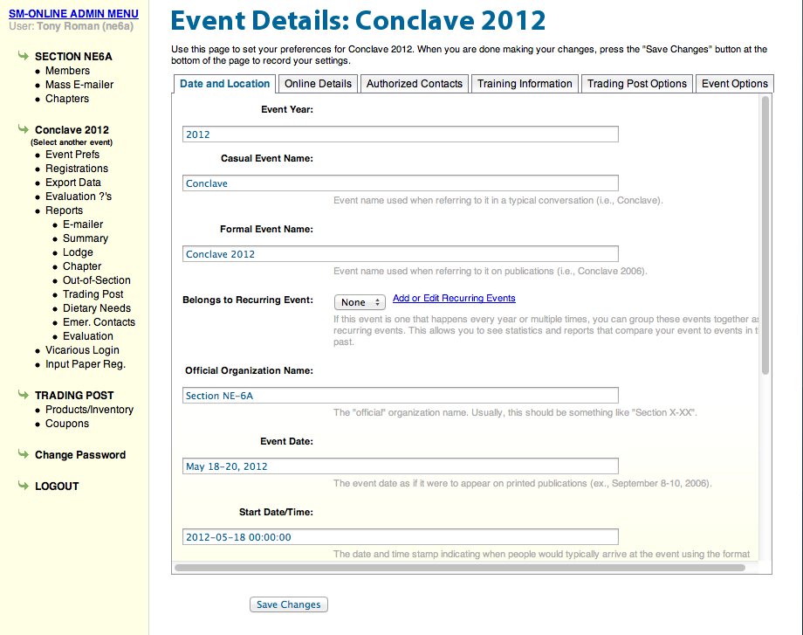

Slide 25
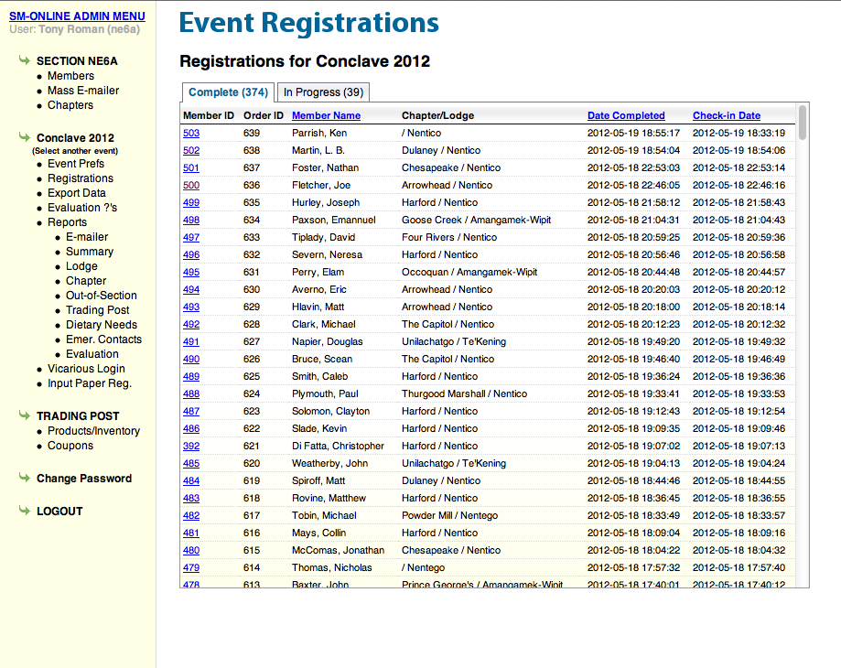

Slide 26
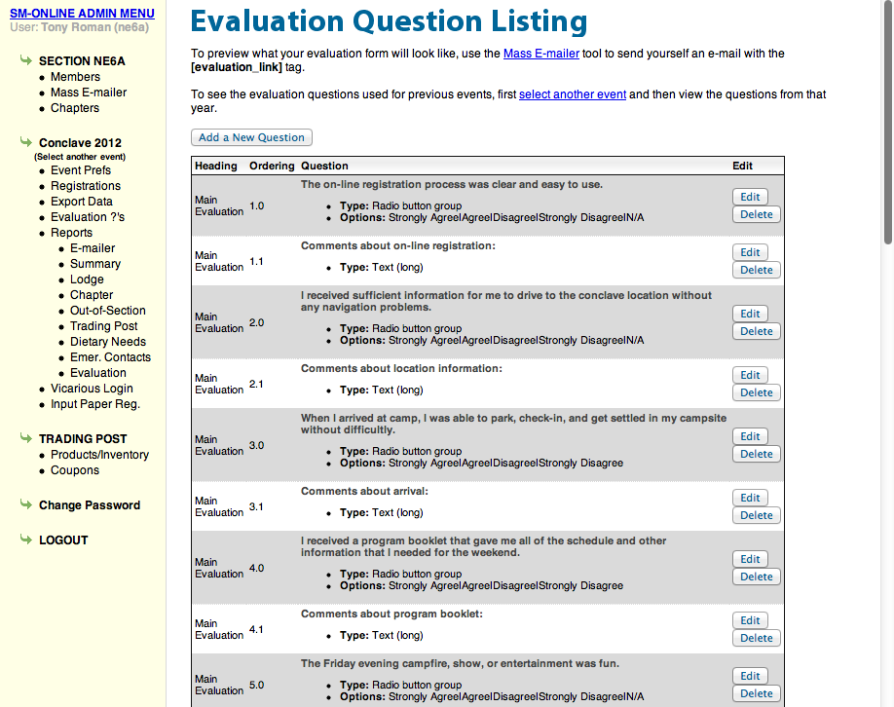

Slide 27
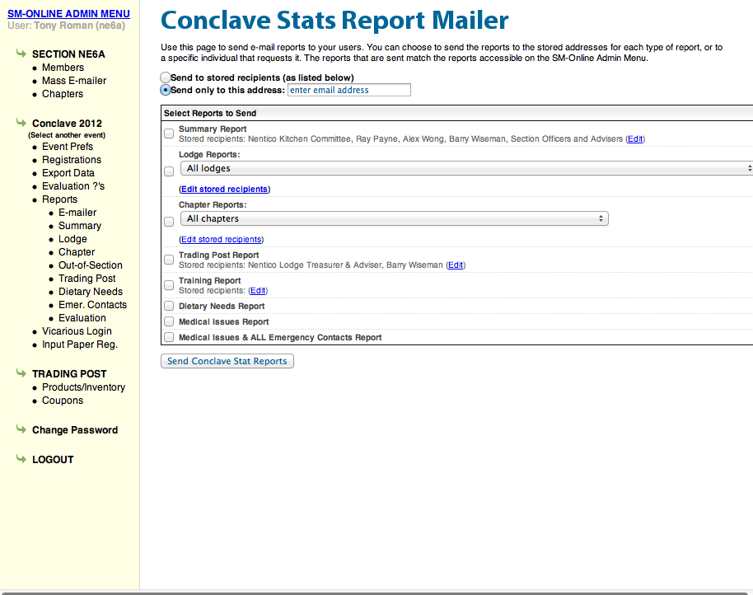

Slide 28
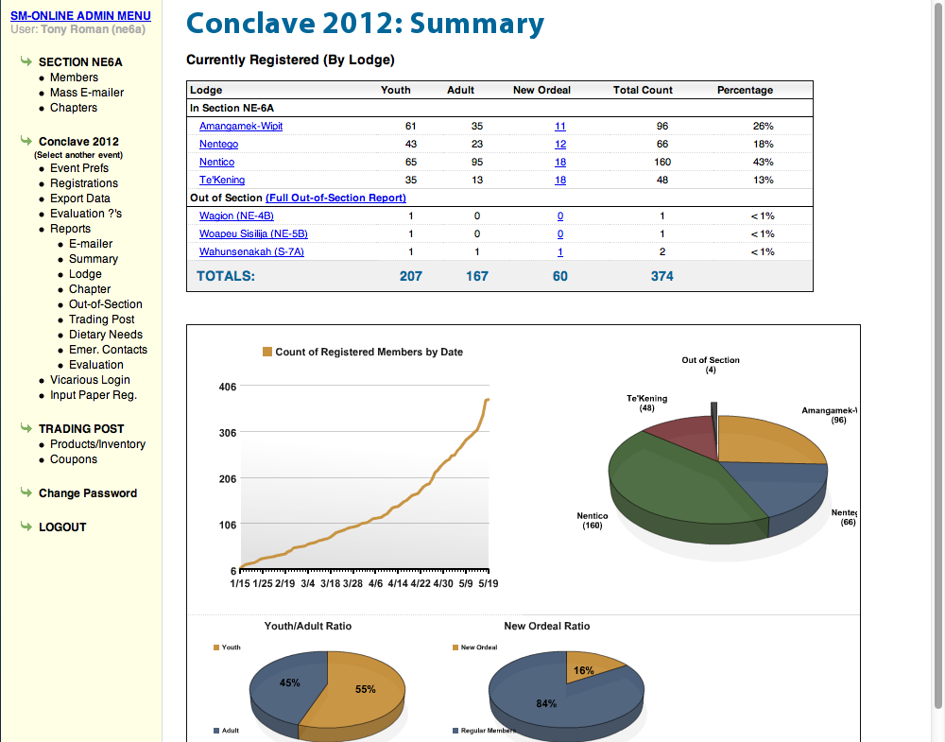

Slide 29
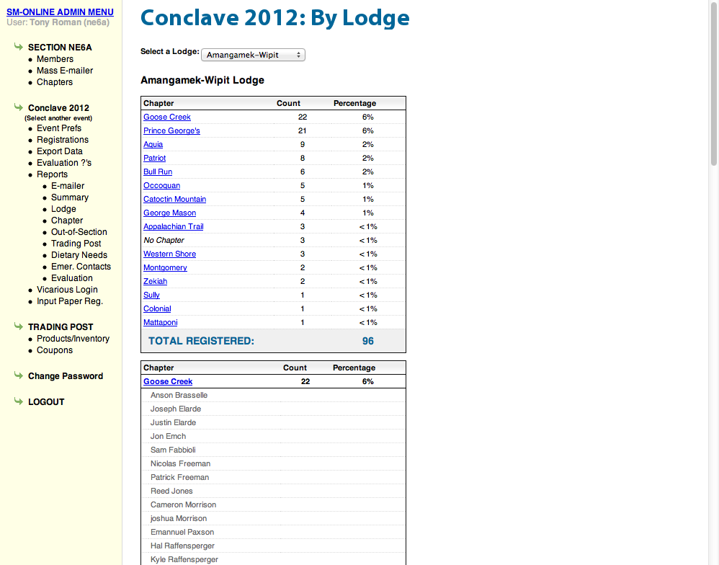

Slide 30
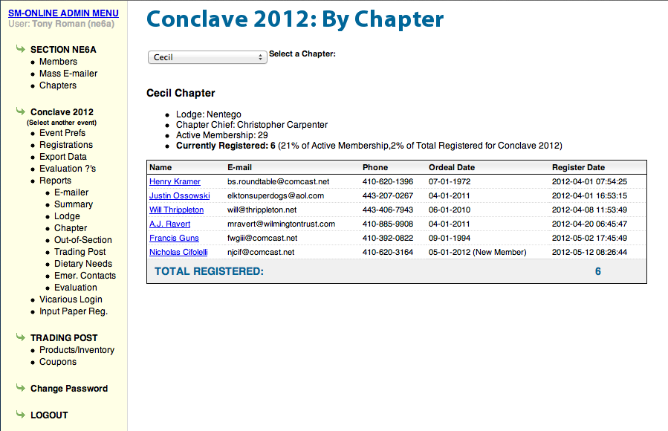

Slide 31
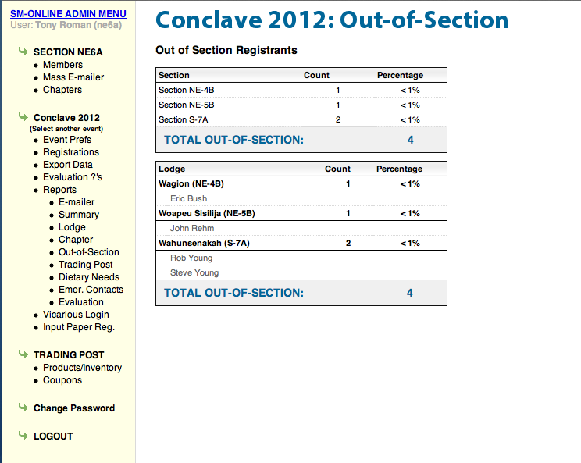

Slide 32
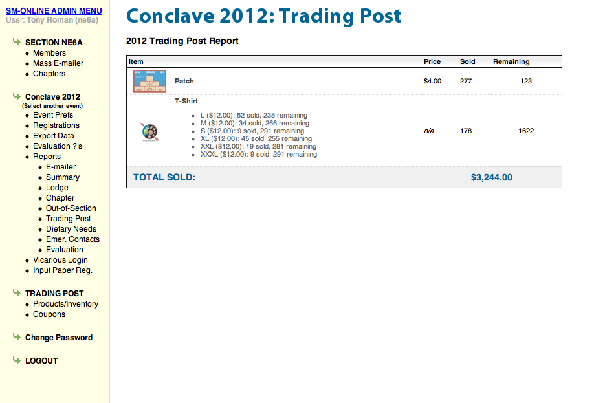

Slide 33
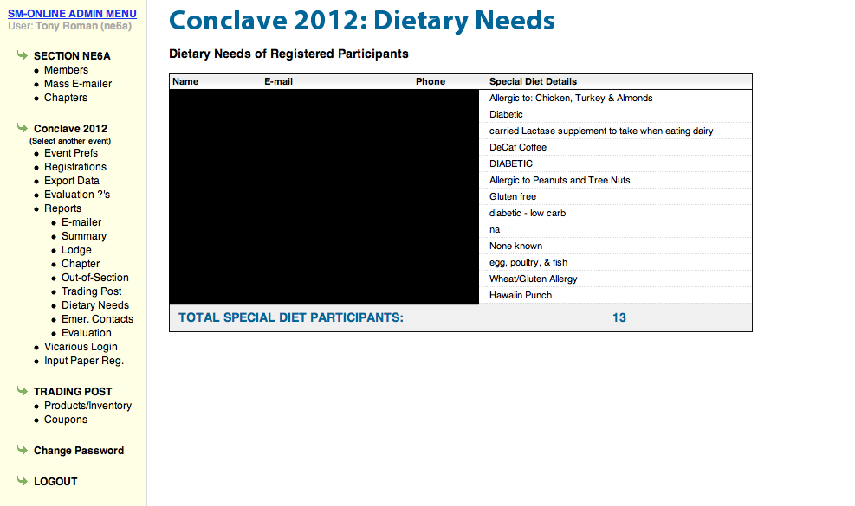

Slide 34
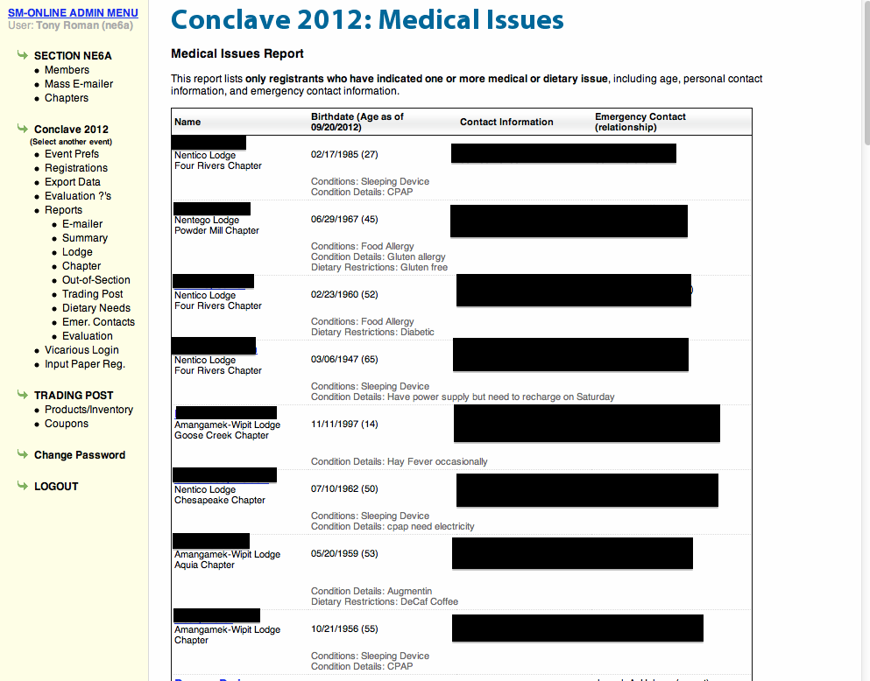

Slide 35
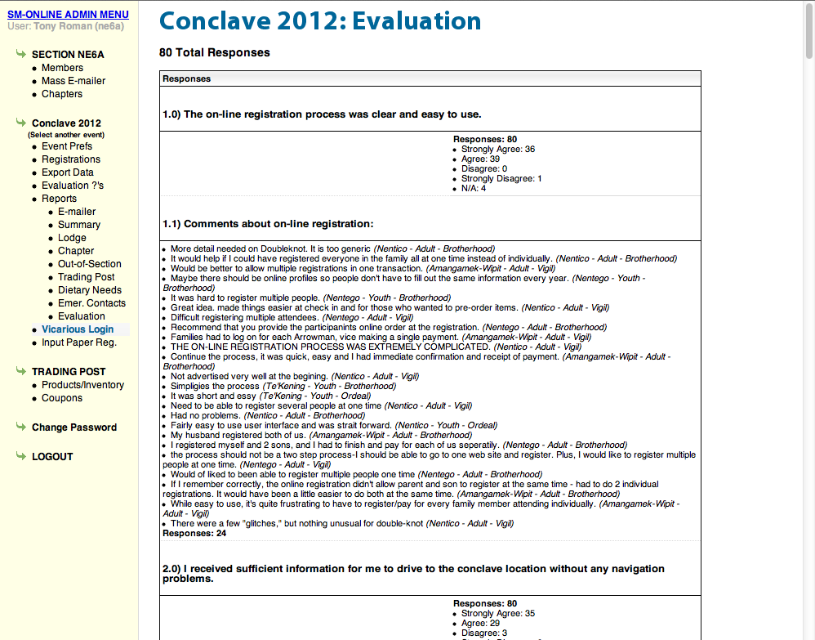

Slide 36
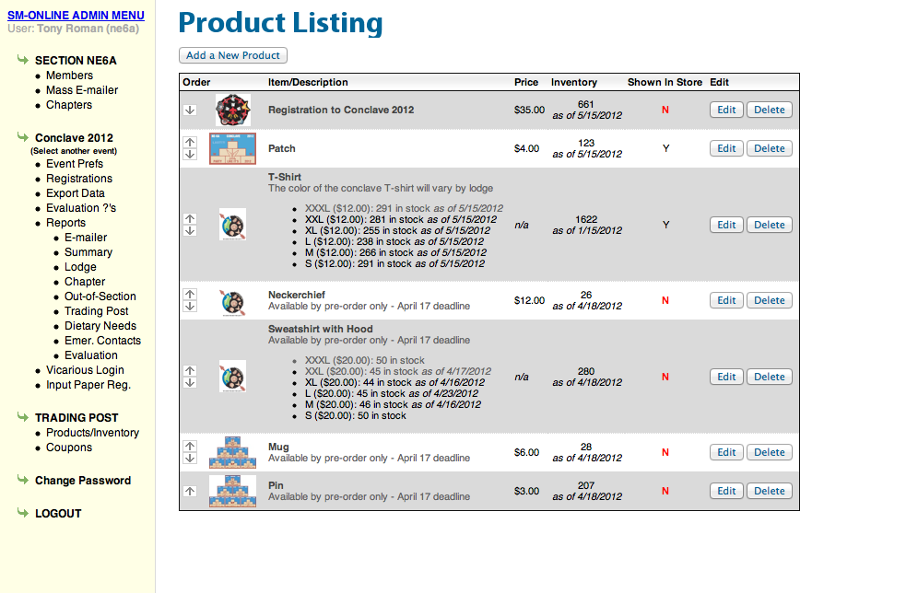

Slide 37
